Slide 1


Community Advisory Group (CAG Meeting #1)
August 19, 2026 | East St. Louis Public Library
Planning and Environmental
Linkages (PEL) Study
IL Route 15 and Bond Avenue in East St. Louis
Notes:
Speaking: IDOT

Slide 2



Community Advisory Group (CAG) Meeting #1
IL Route 15 and Bond Avenue in East St. Louis
Introductions
Notes:
Speaking: IDOT

Slide 3
Community Advisory Group (CAG) Meeting #1
IL Route 15 and Bond Avenue in East St. Louis
Meeting Purpose
Introduce the Study to the Community Advisory Group (CAG)
Discuss the purpose of the CAG and participants’ role in the Study
Identify and discuss existing transportation, economic, and community issues and needs in the study corridor
Document existing conditions in the study corridor, including characteristics and features of the local community that are valuable and/or detrimental to residents, businesses, and stakeholders
Notes:
Speaking: IDOT

Slide 4
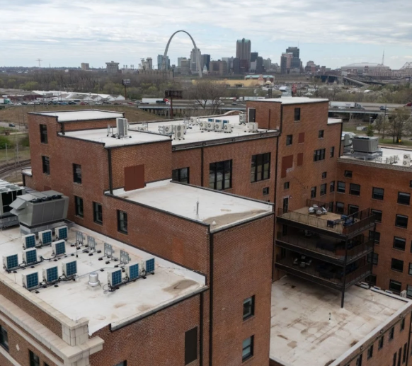
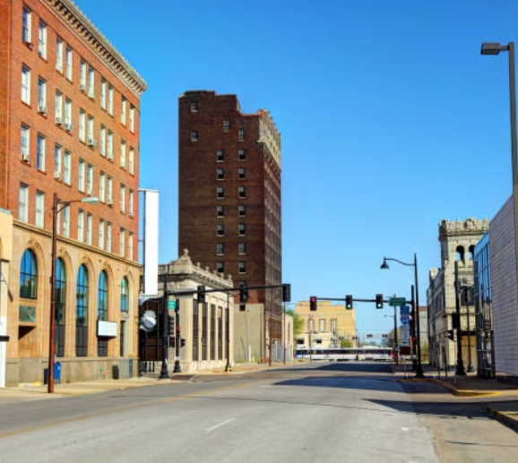
Community Advisory Group (CAG) Meeting #1
IL Route 15 and Bond Avenue in East St. Louis
Agenda
Study Overview
CAG Goals and Expectations
Project Context and Existing Conditions
Purpose and Need
Questions and Closing Remarks
Notes:
Speaking: IDOT

Slide 5
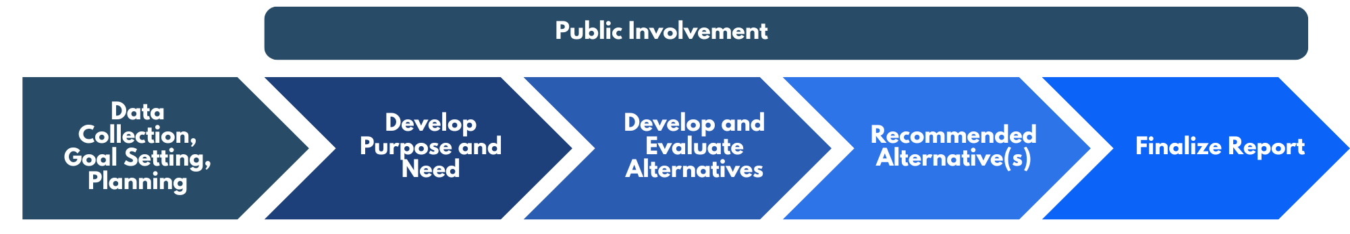
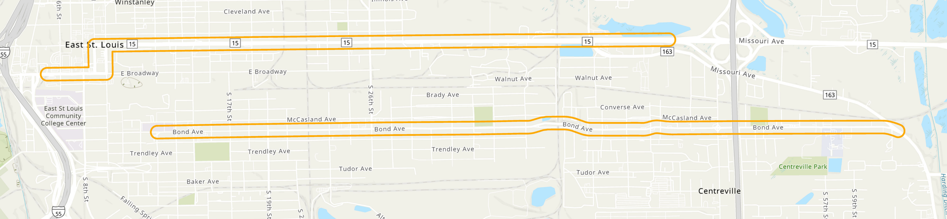
Community Advisory Group (CAG) Meeting #1
East St. Louis PEL Study – IL Route 15 and Bond Avenue
Study Overview
Provide a strategic plan for future transportation improvements and long-term vision for IL Route 15 and Bond Avenue
Study Limits:
  IL Route 15 between I-255 and I-55
  Bond Avenue between IL Route 163 and 8th Street
Corridor includes intersections, at-grade railroad crossings, paved shoulders/concrete curb, and sidewalks
Notes:
Speaking: Caroline – replace picture

Slide 6
Community Advisory Group (CAG) Meeting #1
IL Route 15 and Bond Avenue in East St. Louis
What is a CAG?
A CAG works
with IDOT to:
A diverse group of voluntary stakeholders identified by elected community leaders and the Illinois Department of Transportation (IDOT) to represent the project study area and serve as a liaison between IDOT, the community, and roadway users.
Identify stakeholder interests & values
Develop improvement options
Evaluate the potential effects of those options on community resources
Notes:
Speaking: Caroline

Slide 7
Community Advisory Group (CAG) Meeting #1
IL Route 15 and Bond Avenue in East St. Louis
CAG Goals & Expectations
Input from all participants in the process is valued and considered.
All participants must keep an open mind and participate openly, honestly, and respectfully.
All participants should work collaboratively and cooperatively to seek a general understanding of the project and the perspectives of others.
A general understanding of agreement is “when a majority of the stakeholders agrees on a particular issue, while the remainder of stakeholders agrees its input has been heard and duly considered and that the process as a whole was fair.”
Stakeholder input will be documented and duly considered in the Study’s needs identification, and the future development and evaluation of potential solutions.
Notes:
Speaking: Caroline

Slide 8
Community Advisory Group (CAG) Meeting #1
IL Route 15 and Bond Avenue in East St. Louis
CAG Goals & Expectations
All participants in the process must treat each other with respect and dignity.
The study must progress at a reasonable pace, with each CAG meeting building on the previous meeting.
IDOT and FHWA will serve as the lead agencies and make final study decisions.
Meetings will be documented, and meeting summaries will be made available to the public.
Participants should express their ideas, feelings, and concerns so that the group can consider them during the study.
Participants should support the guidance provided by the CAG facilitator.
Notes:
Speaking: Caroline

Slide 9
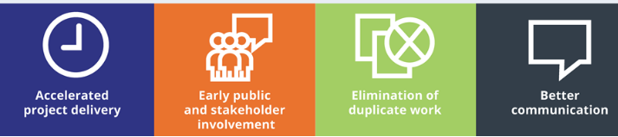
Community Advisory Group (CAG) Meeting #1
IL Route 15 and Bond Avenue in East St. Louis
What is a PEL?
A PEL (Planning and Environmental Linkage) is a collaborative approach involving local and State DOTs, Federal agencies, and resource agencies that links transportation planning to the environmental review process while considering environmental, community, and economic goals early in the process.
Why use a PEL?
Notes:
Speaking: Caroline

Slide 10
Community Advisory Group (CAG) Meeting #1
IL Route 15 and Bond Avenue in East St. Louis
Project Context &
Existing Conditions
What do we currently know about the corridor?
Notes:
Speaking: Jackie (CDM)

Slide 11
Community Advisory Group (CAG) Meeting #1
IL Route 15 and Bond Avenue in East St. Louis
Guided by Livability Framework
A living document used to measure, plan, and improve the quality of life in a community.
Will be used to support the PEL Study by guiding a collaborative, inclusive, and community-centered planning process.
Evaluates factors like public health, safety, the environment, and economic health to ensure neighborhoods are comfortable, fair, and functional for everyone.
Will be available on the project website and updated as the project progresses.
Notes:
Speaking: Jackie (CDM)

Slide 12
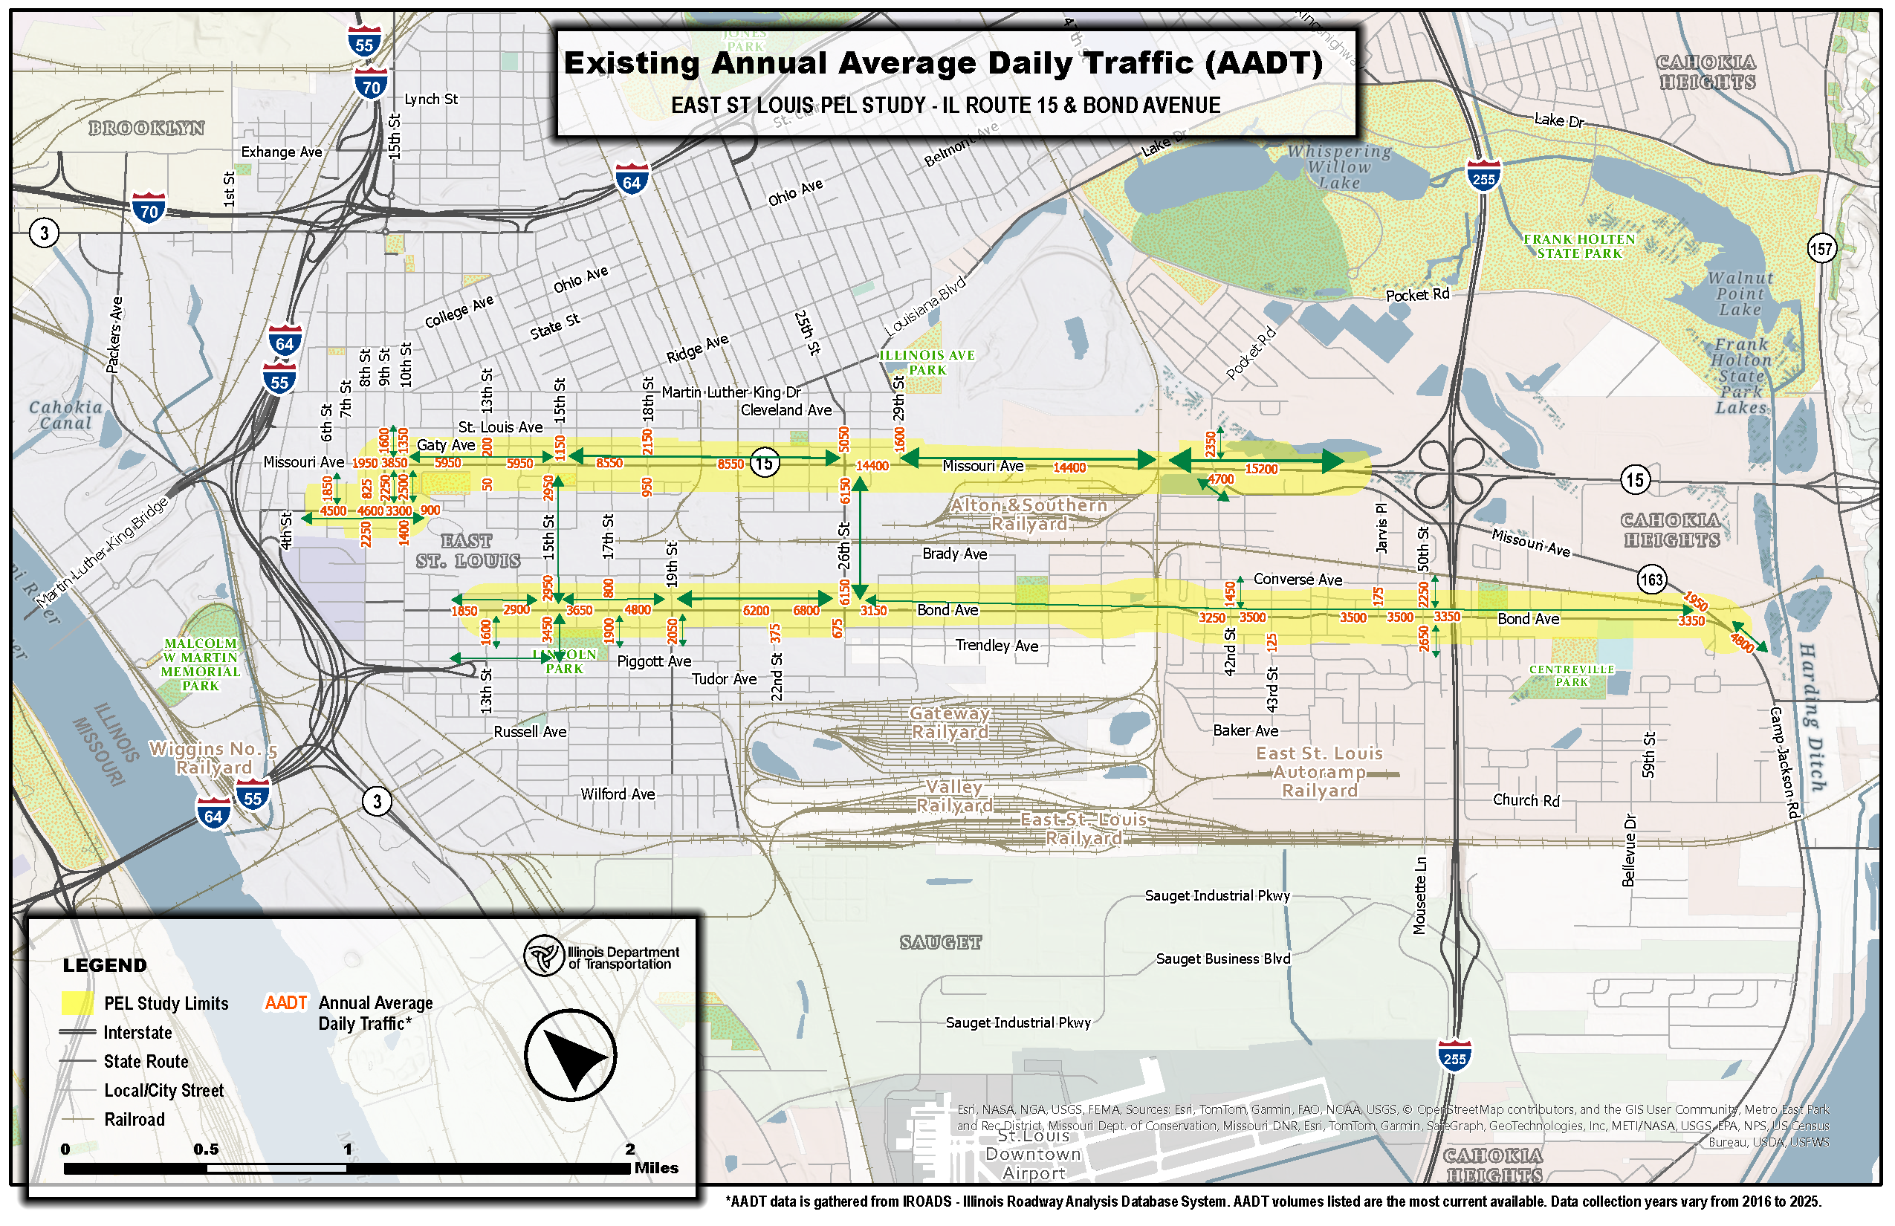
Community Advisory Group (CAG) Meeting #1
East St. Louis PEL Study – IL Route 15 and Bond Avenue
Average Daily Traffic (ADT) Volumes
Notes:
Speaking: Jackie (CDM)

Slide 13
Notes:
Speaking: Jackie (CDM)

Slide 14
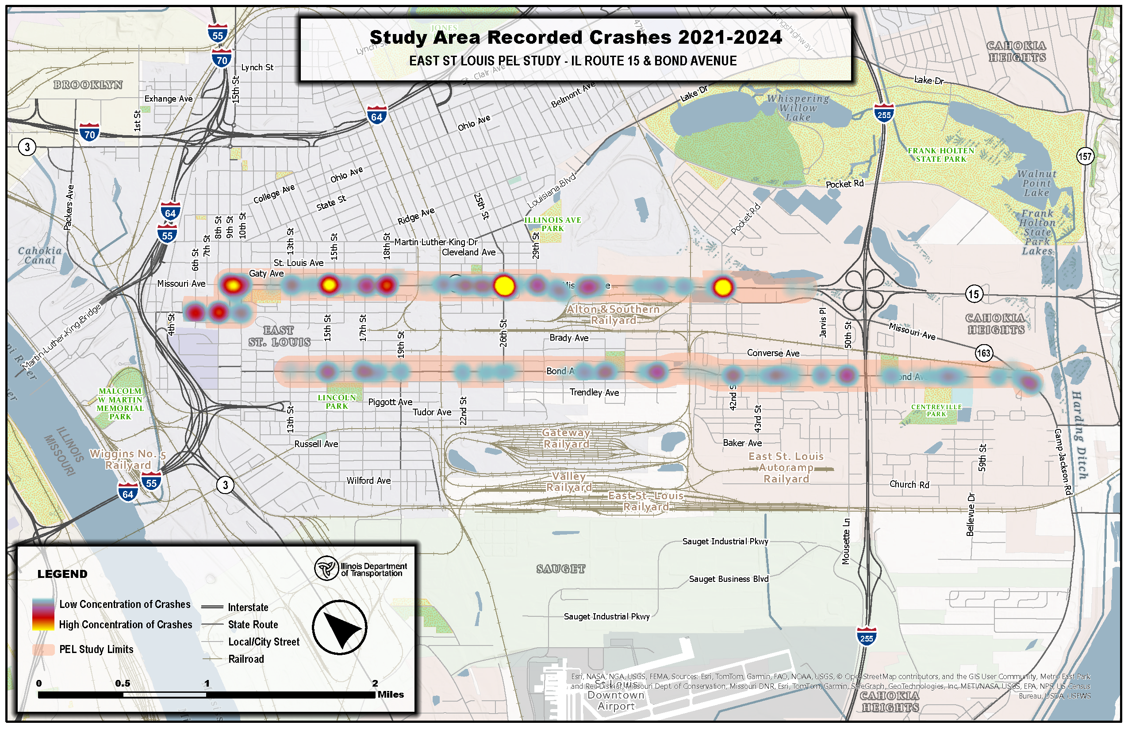
Community Advisory Group (CAG) Meeting #1
East St. Louis PEL Study – IL Route 15 and Bond Avenue
Crash Heat Map
Notes:
Speaking: Jackie (CDM)

Slide 15
Notes:
Speaking: Jackie (CDM)

Slide 16
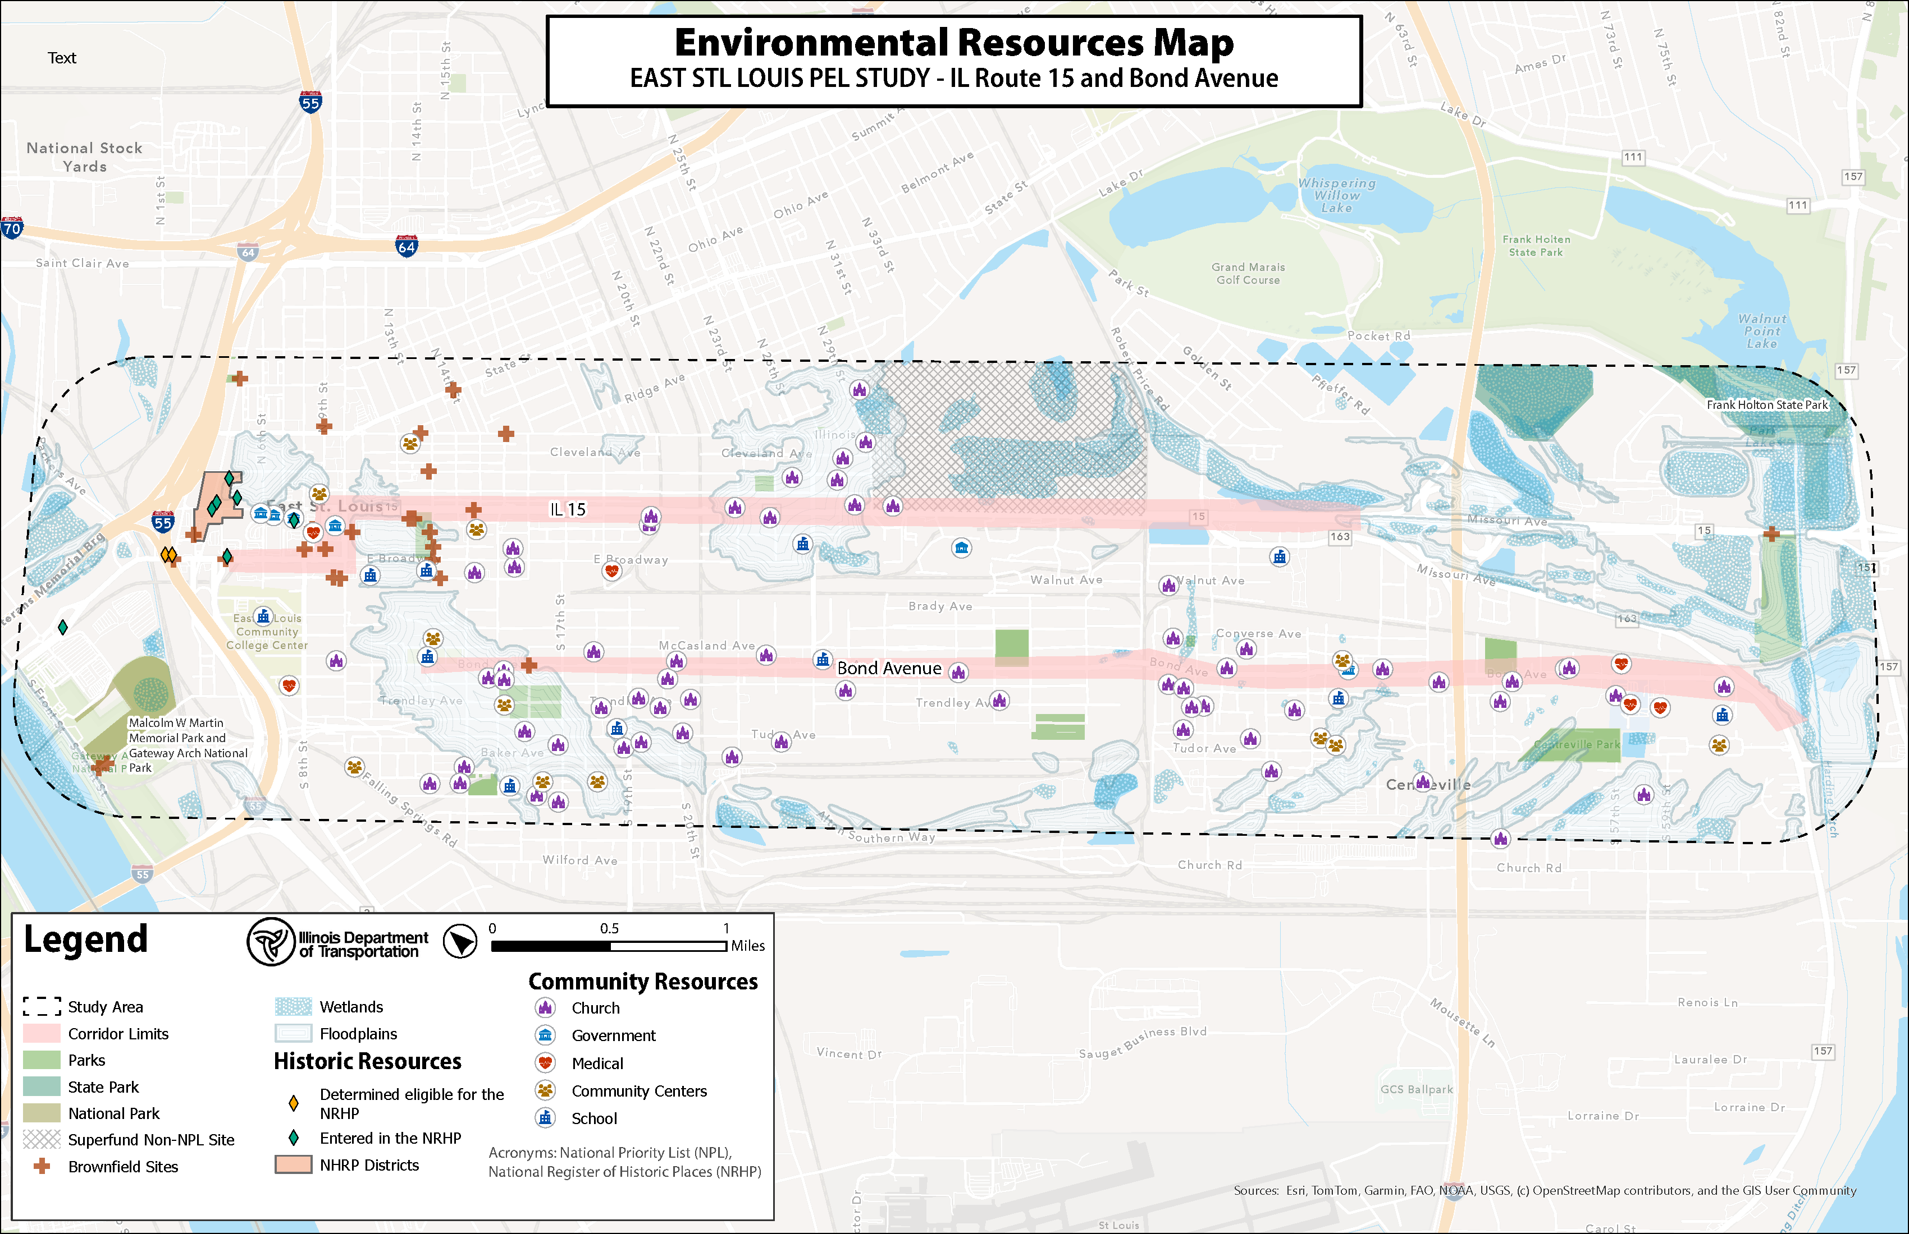
Community Advisory Group (CAG) Meeting #1
East St. Louis PEL Study – IL Route 15 and Bond Avenue
Environmental
Notes:
Speaking: Jackie (CDM)

Slide 17
Notes:
Speaking: Jackie (CDM)

Slide 18
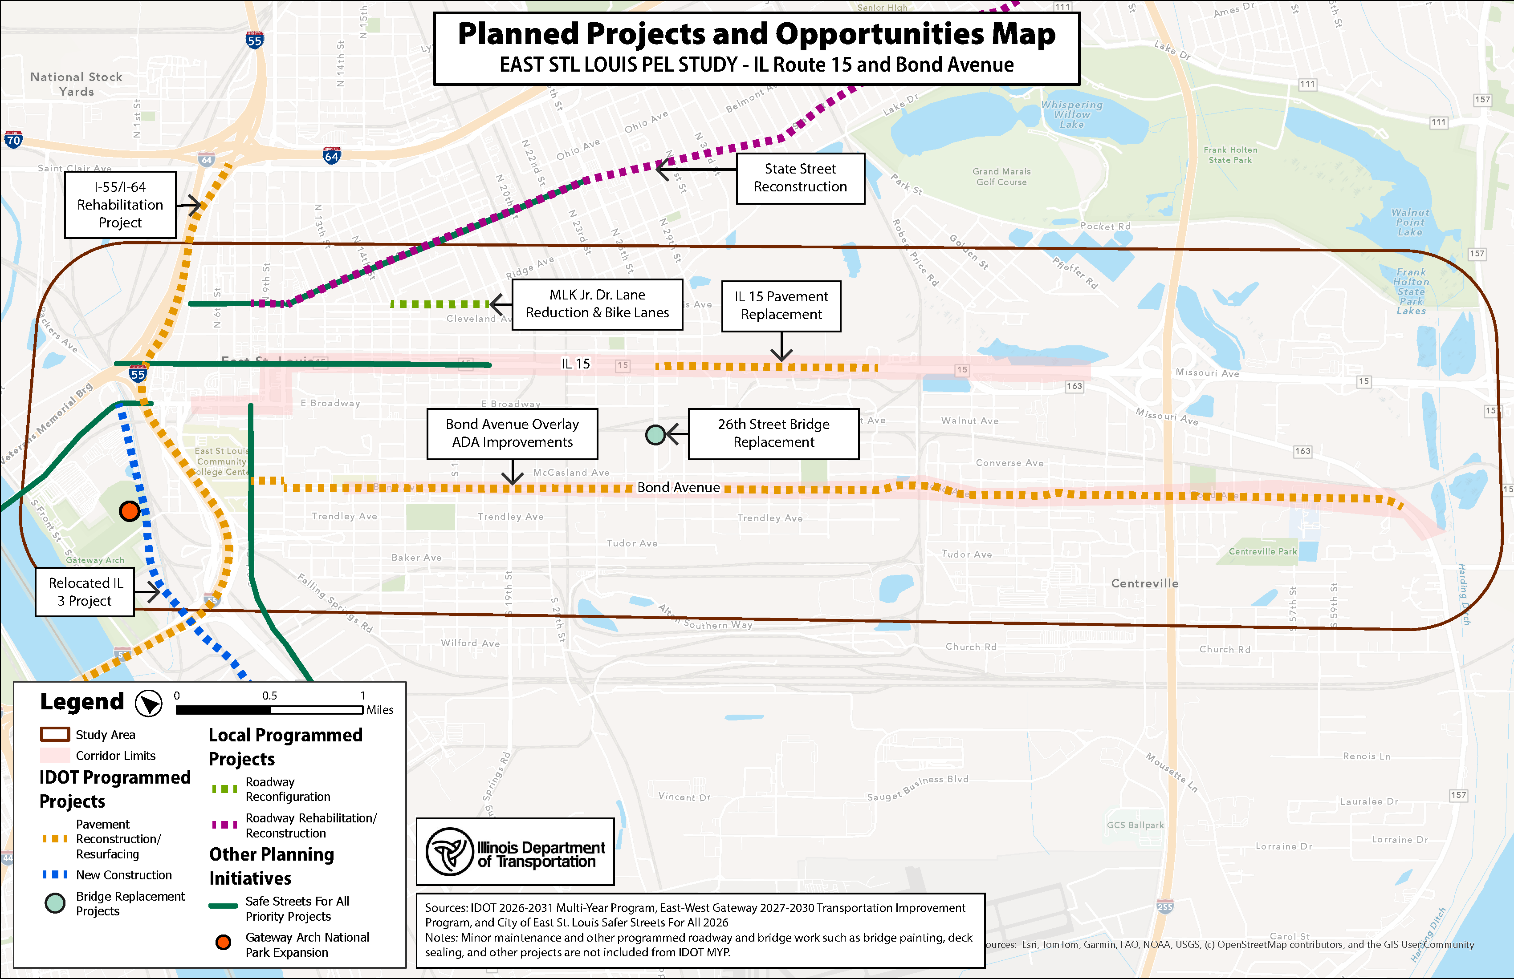
Community Advisory Group (CAG) Meeting #1
IL Route 15 and Bond Avenue in East St. Louis
Surrounding Projects/Opportunities
Notes:
Speaking: Jackie (CDM)

Slide 19
Notes:
Speaking: Jackie (CDM)

Slide 20
Community Advisory Group (CAG) Meeting #1
IL Route 15 and Bond Avenue in East St. Louis
What is the Purpose and Need Statement?
Required by National Environmental Policy Act (NEPA)
Identifies what action needs to be taken
Demonstrates problems that already exist, or which will exist if a project is not implemented
Justifies the need for the action
Helps define what constitutes a reasonable alternative
It does not
Recommend a preferred alternative
Notes:
Speaking: Jackie (CDM)

Slide 21
Community Advisory Group (CAG) Meeting #1
IL Route 15 and Bond Avenue in East St. Louis
Discussion &
Group Feedback
Help us identify issues and needs in the corridor
Notes:
Speaking: Geri

Slide 22
Community Advisory Group (CAG) Meeting #1
IL Route 15 and Bond Avenue in East St. Louis
On your own, take 5 minutes to:
List issues and needs along the study corridor that are important to you.
What is your vision for this corridor? What would you like it to become?
What are you biggest safety concerns?
What economic opportunities or investments is the community missing out on?
How do you typically use IL Route 15 and Bond Avenue?
Topics may be general or specific.
No limit to the number of issues and needs.
There are no wrong answers.
From the above, respond to those most important to you.
Keep in Mind
Notes:
Speaking: Geri

Slide 23
Community Advisory Group (CAG) Meeting #1
IL Route 15 and Bond Avenue in East St. Louis
Discuss as a Group
Ideas generated
Identify most prominent issues and needs for the corridor
Document those issues and group similar issues and needs for discussion
Notes:
Speaking: Geri

Slide 24
Community Advisory Group (CAG) Meeting #1
IL Route 15 and Bond Avenue in East St. Louis
Next Steps
Develop Purpose and Need Statement
Existing Conditions data collection and analyses
Continue stakeholder engagement through Focus Groups
Public Meeting planned for Fall 2026
Develop various improvement alternatives for consideration and discussion
Next CAG Meeting
Anticipated October 2026
Notes:
Speaking: Geri

Slide 25
Community Advisory Group (CAG) Meeting #1
IL Route 15 and Bond Avenue in East St. Louis
Thank You
Questions after you leave today? Contact the Project Team!
www.eaststlouispel.com
Fill out a comment form on our website or encourage others to do so!
Point of Contact
David Holloway
618.345.8918
david.r.holloway@illinois.gov
Notes:
Speaking: Geri

